Slide 1
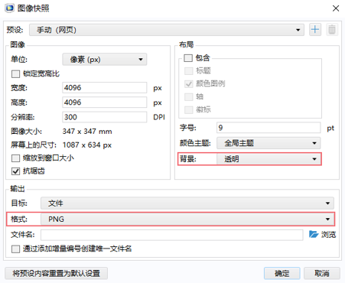
海报制作指南
您可以使用自己常用的模板，也可以参照 COMSOL 提供的模板制作海报。
制作海报过程中，请注意以下事项：
海报尺寸为 91.44cm/36inch（宽） x 121.92cm/48inch（高）的纵向样式，页面边距为 2.54cm/1inch。
建议使用白色或浅色背景。
海报中的中文字体请使用等线，英文字体请使用 Calibri。
请保持海报标题字号最大（90-120 pt.），其次是副标题字号（70-80 pt.）。图表标题、参考文献和所属机构的字号最小（18-40 pt.）。
请注意:
红色实线是打印时将被裁切掉的 3 mm 区域。
红色虚线表示在打印过程中可能会被裁切掉的小边距。
如何在 COMSOL 中导出高清图片
使用 COMSOL 软件中的“图像快照”功能可以导出高质量的透明背景图片。
红框标出了其中两项重要设置。按此设置将导出一张可用于海报最上方蓝色区域的图片。

Slide 3
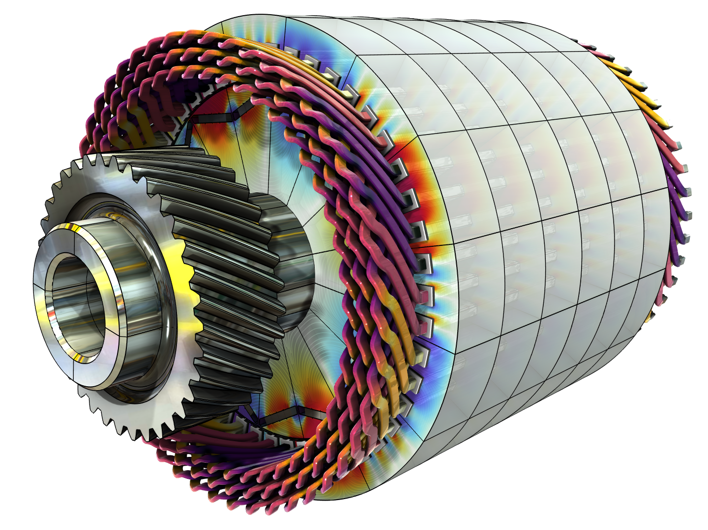
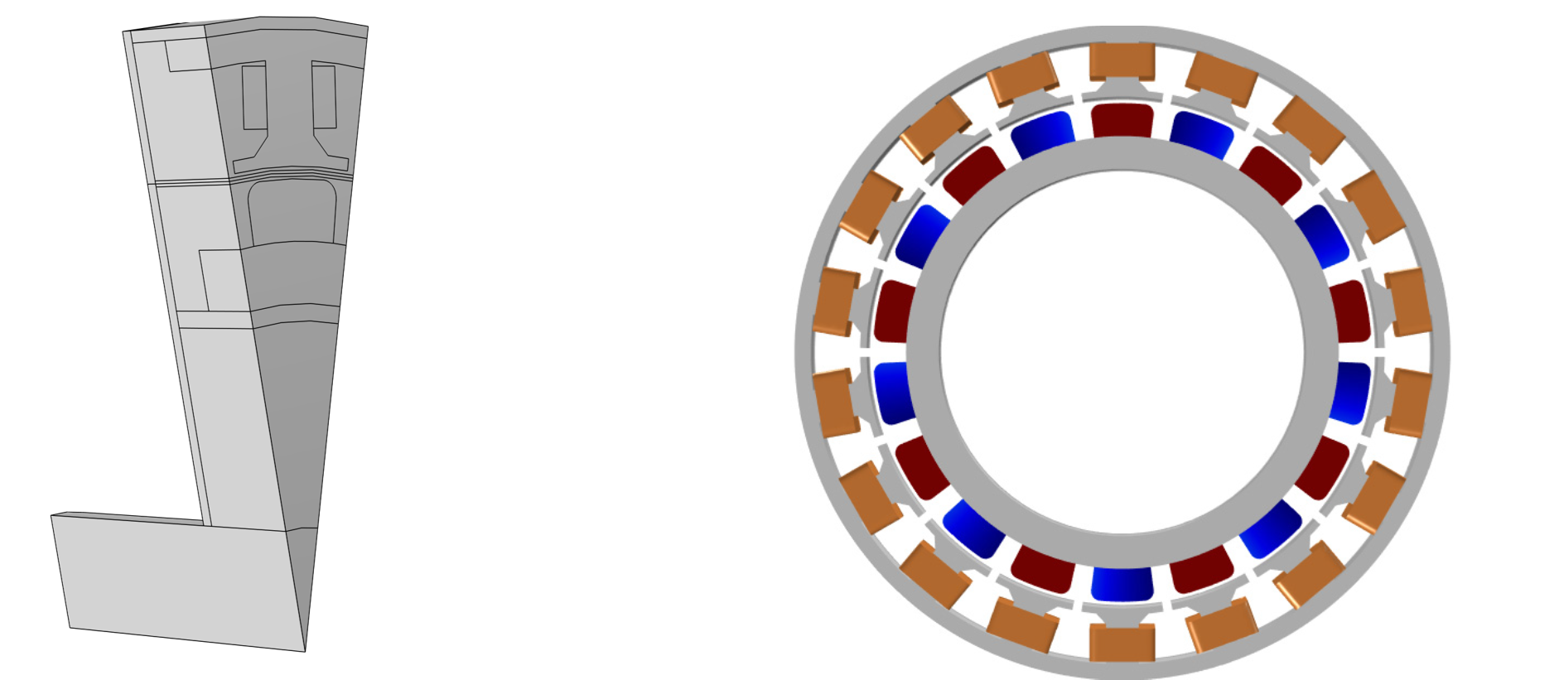
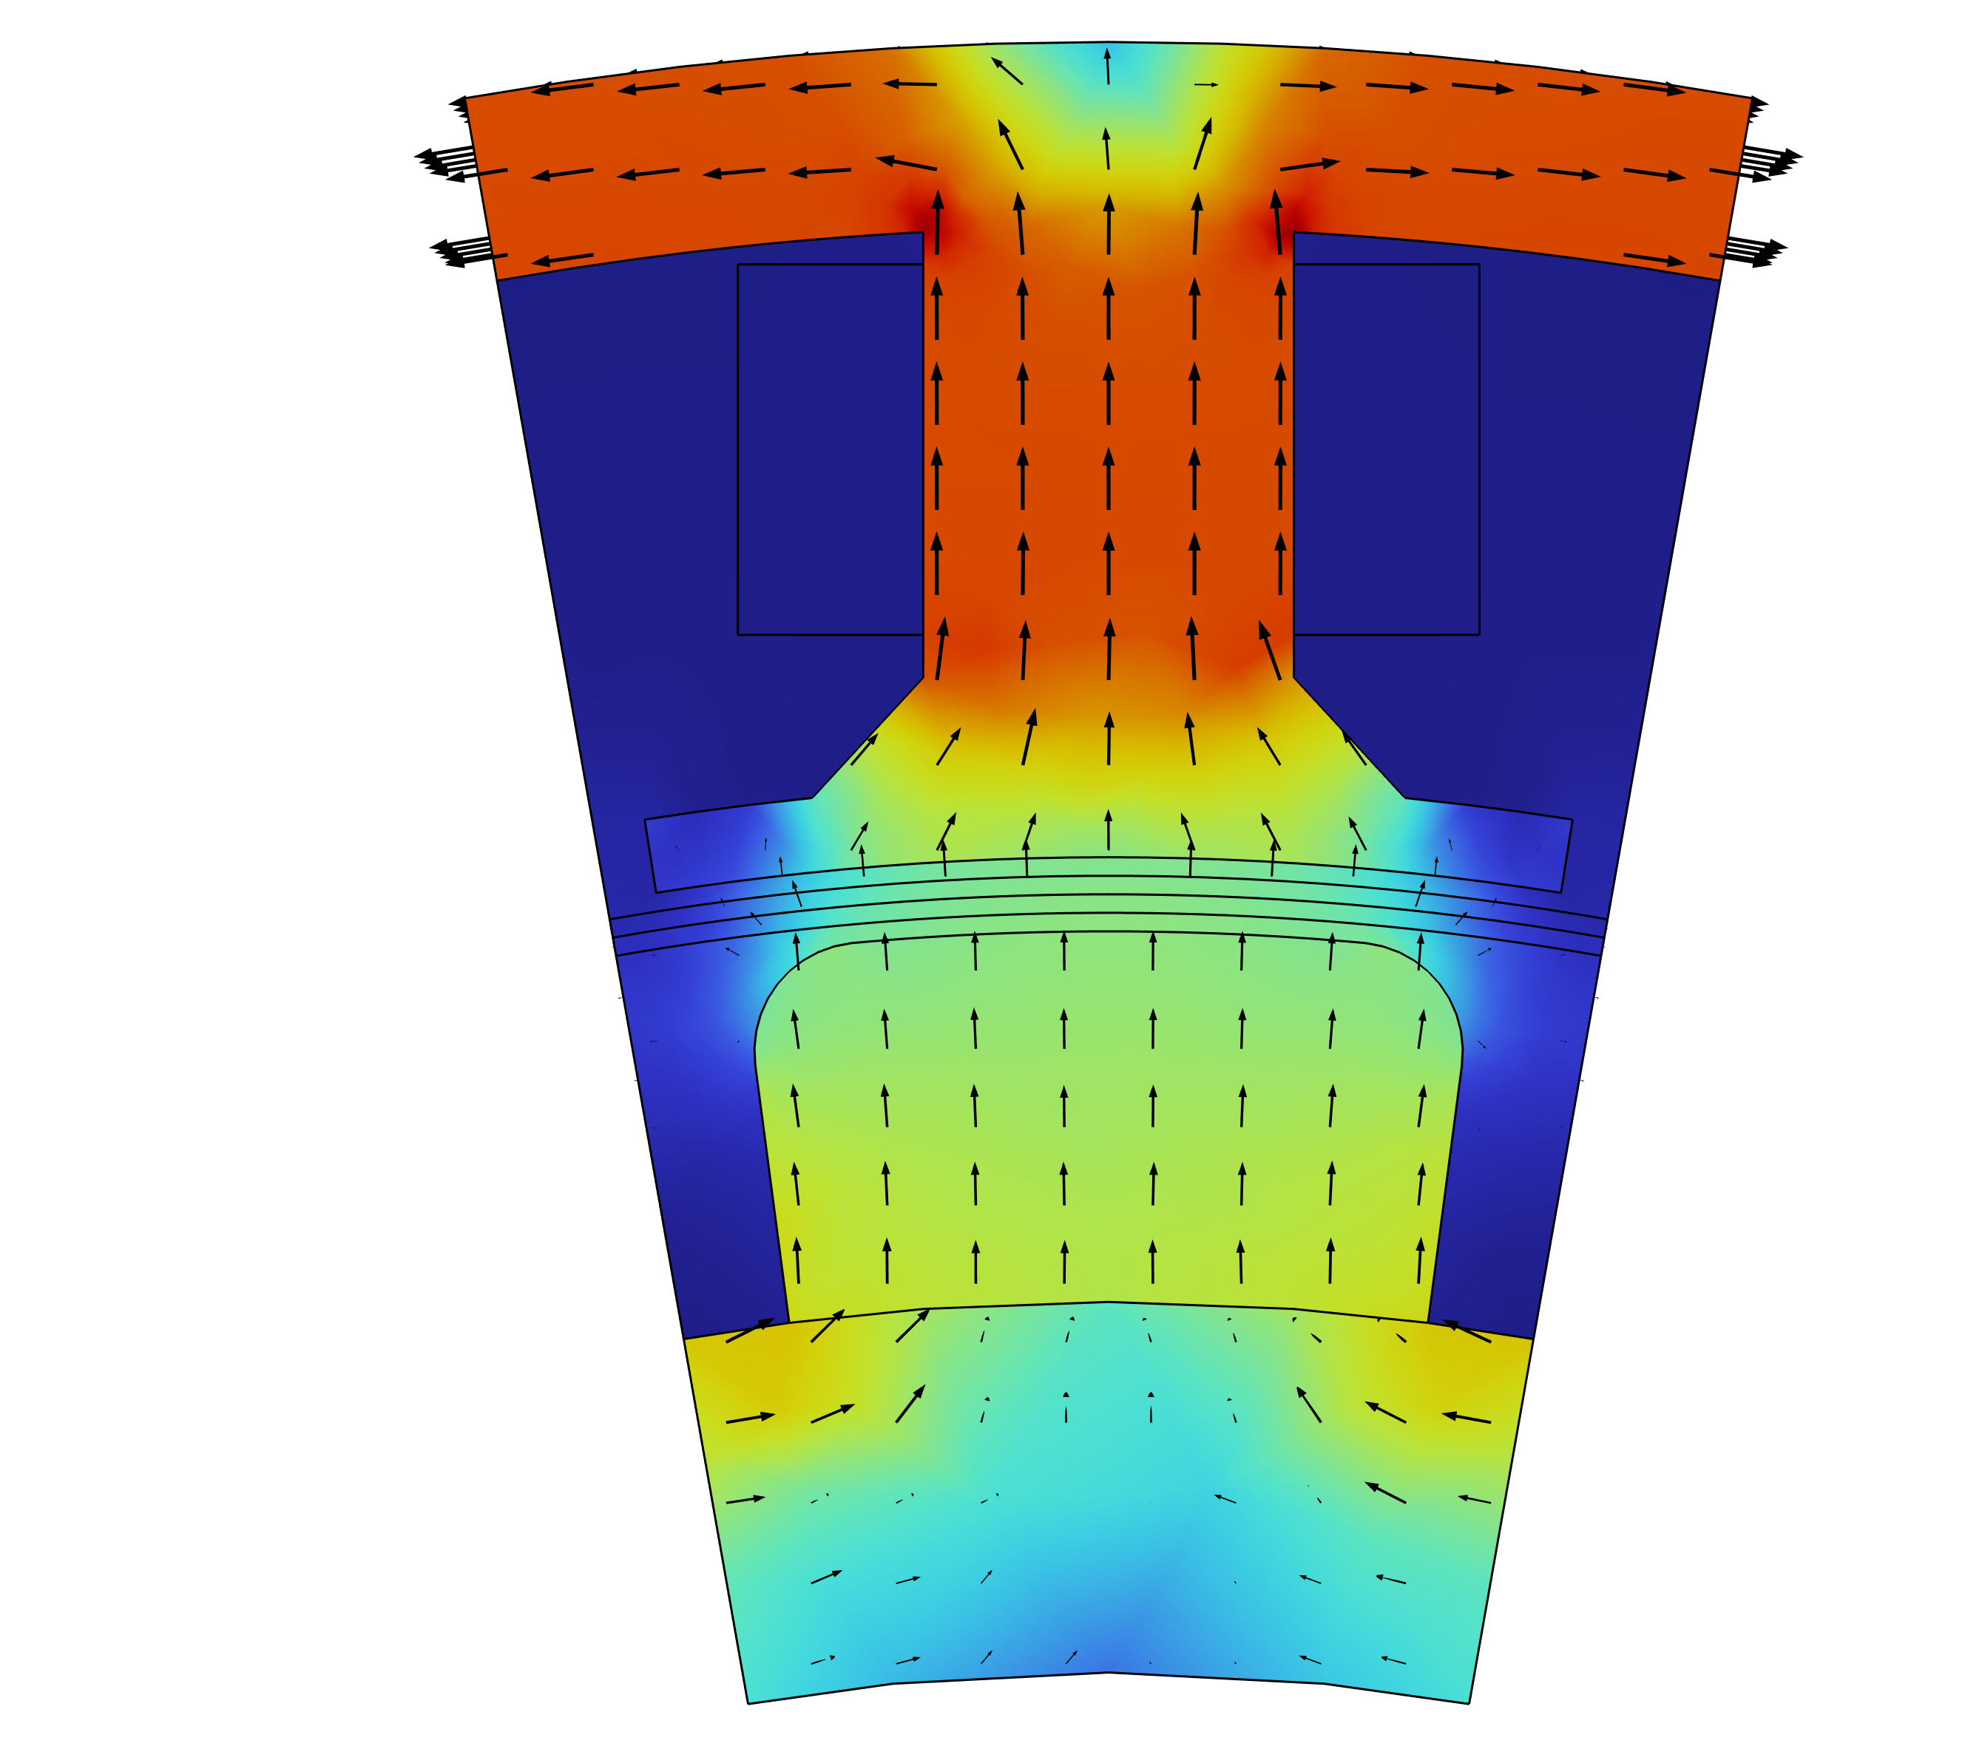
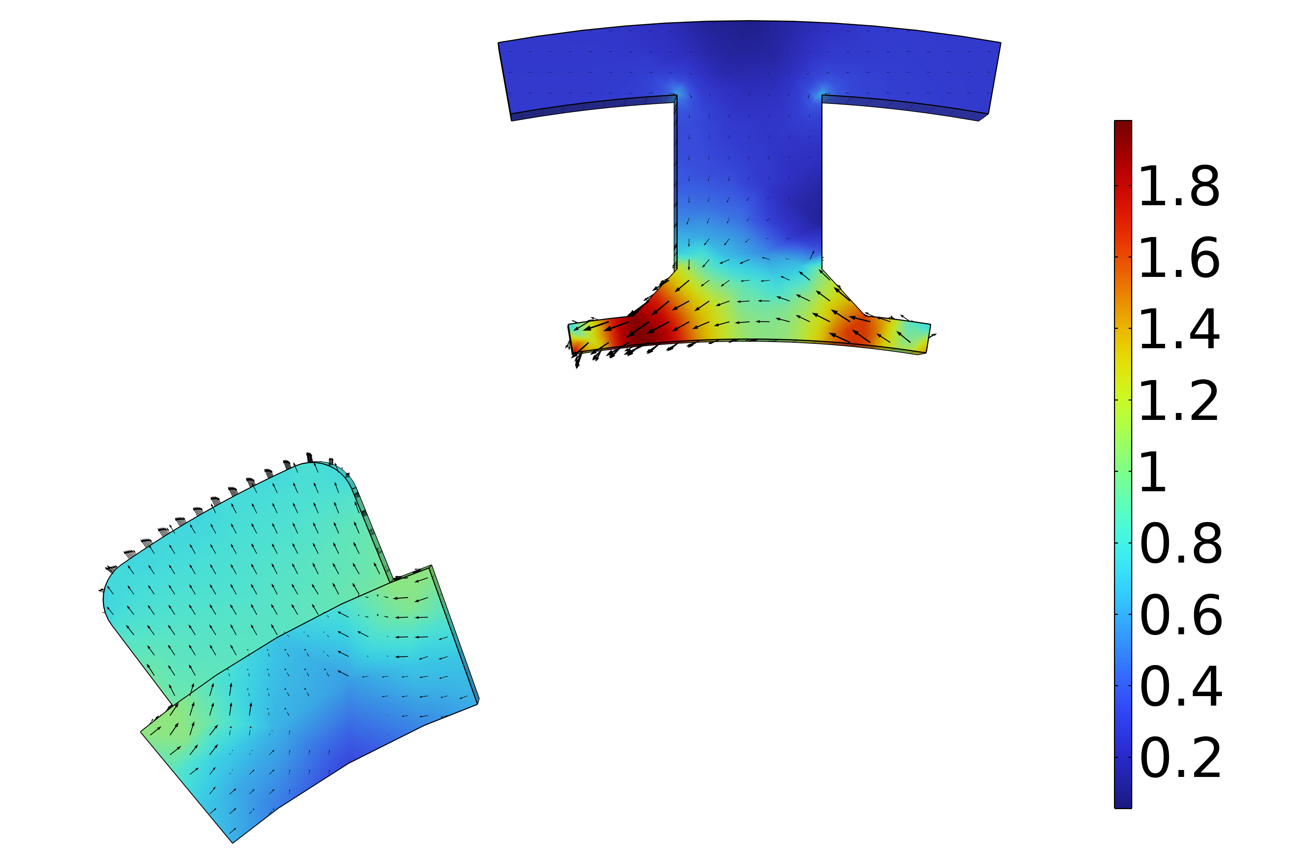
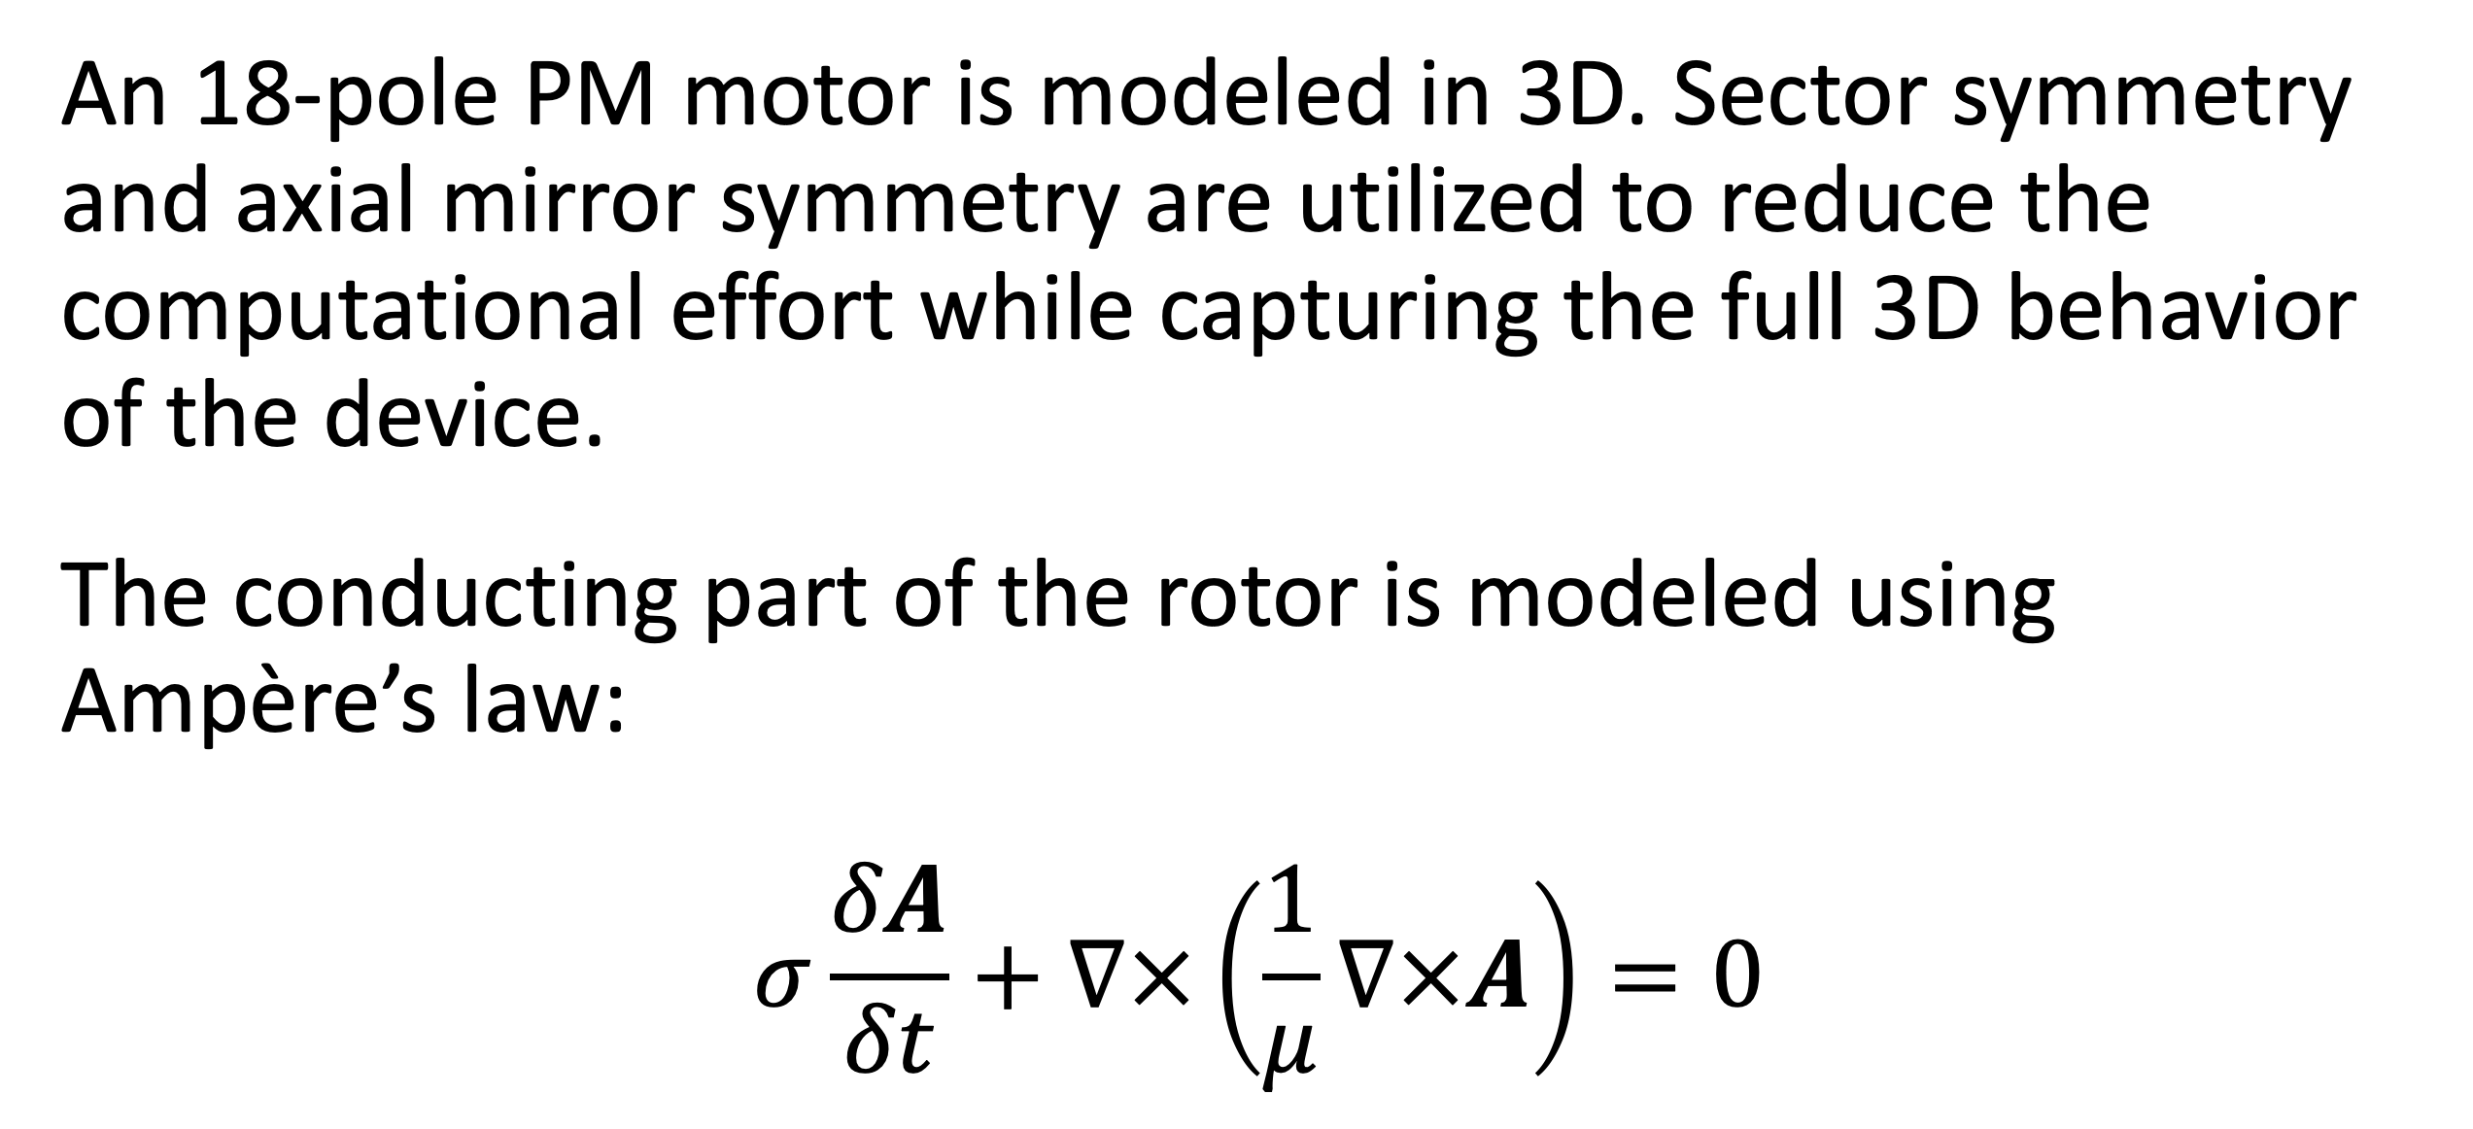
Analysis of a Permanent Magnet Motor in 3D
Optimize permanent magnet (PM) motor performance by understanding their full behavior, including sensitivity to high temperatures.
J. A. Smith¹, M. B. Smith²
1. Department (if applicable), Organization, City, Country.
2. Department (if applicable), Organization, City, Country.
Abstract
While PM motors are valued for the energy savings that they provide, there are some design limitations to address. For example, permanent magnets are sensitive to high temperatures. Such temperatures can occur when currents, particularly eddy currents, generate heat losses.
The findings offer greater insight into the behavior of PM motors, particularly by capturing the eddy current losses that occur within the magnets. This information serves as a useful resource for improving the design of PM motors, and therefore the technology they help power.
Methodology
An 18-pole PM motor is modeled in 3D. Sector symmetry and axial mirror symmetry are utilized to reduce the computational effort while capturing the full 3D behavior of the device.
The conducting part of the rotor is modeled using Ampère’s law:
$$σ\frac{δA}{δt}+∇×\left(\frac{1}{μ}∇×A\right)=0$$
FIGURE 1. Left: Permanent motor sector. Right: Drawing of the PM motor.
Results
The results can be seen in Figure 2, which shows the magnetic flux density for the motor in it’s stationary state, that is, the initial conditions for the time-dependent simulation. In this state, the coil current is zero. It also shows the magnetic flux density for the motor after revolving one sector angle. In this plot, the air and coil domains are excluded in order to get a better view.
FIGURE 2. Left: Magnetic flux density from the permanent magnets with only the rotor at rest. Right: Magnetic flux density after revolving one sector angle.
REFERENCES
1. Author first initial and last name, “Article Title”, Journal, Volume (vol.), Page numbers (pp.), Year.
2. Author first initial and last name, “Article Title”, Journal, Volume (vol.), Page numbers (pp.), Year.
3. Author first initial and last name, “Article Title”, Journal, Volume (vol.), Page numbers (pp.), Year.

Slide 4
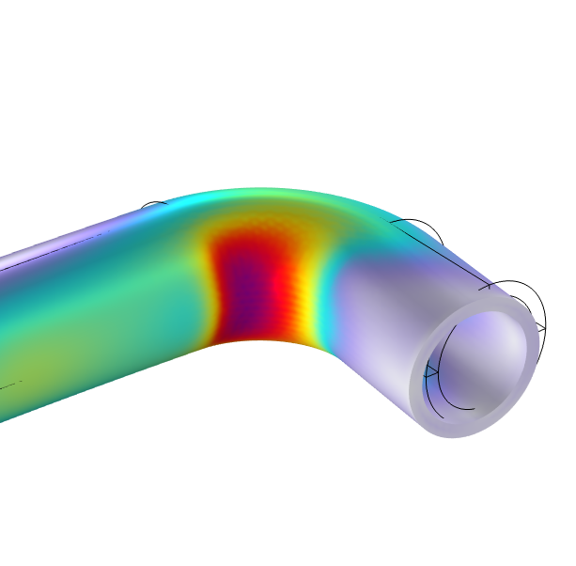
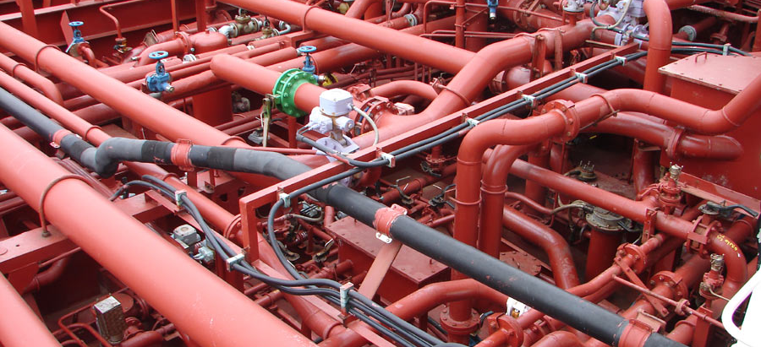
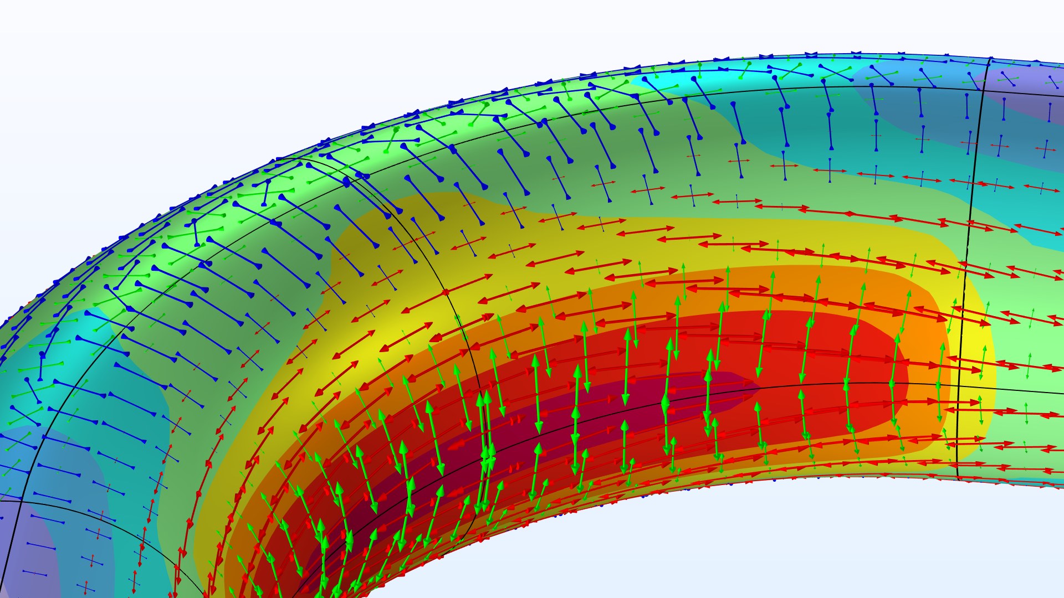
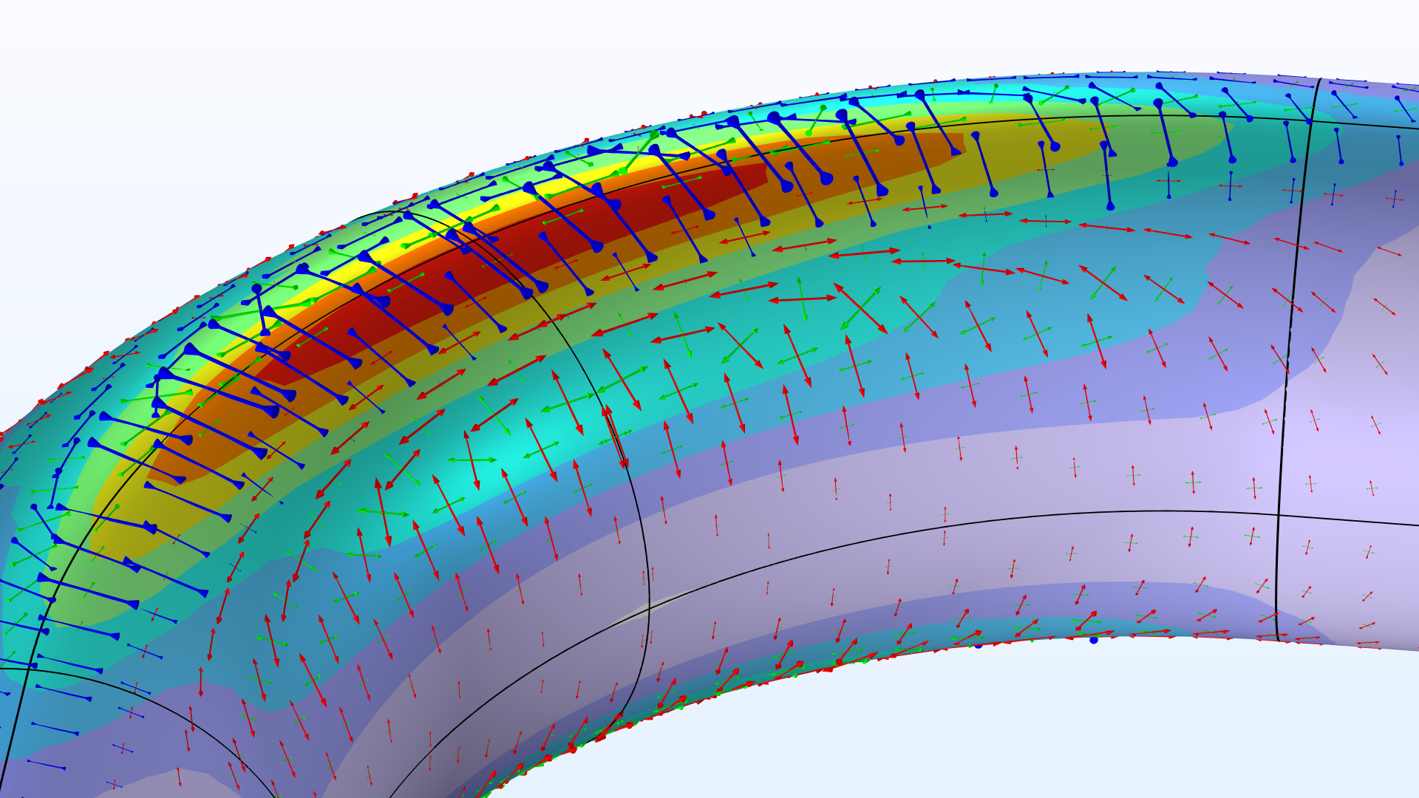
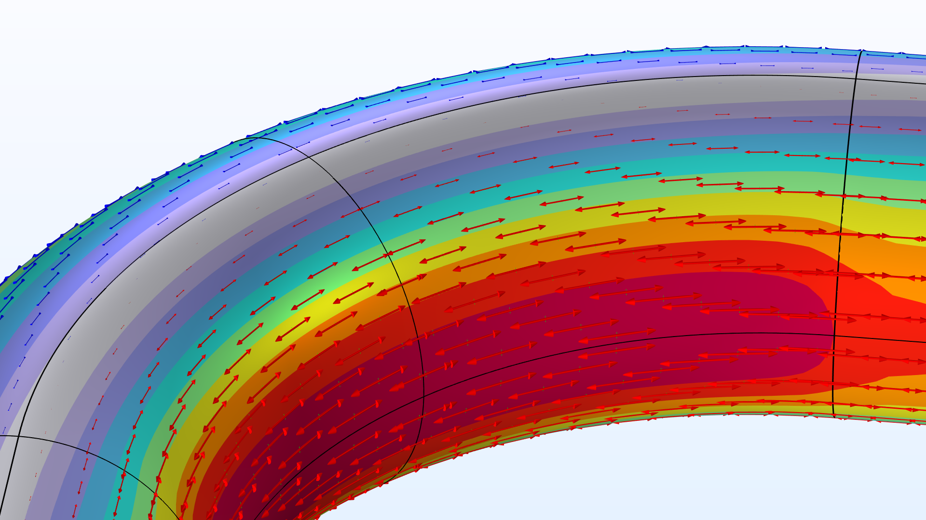
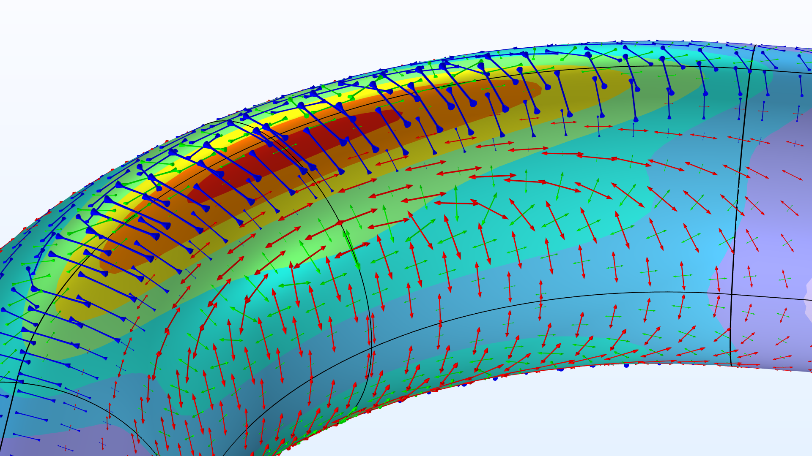
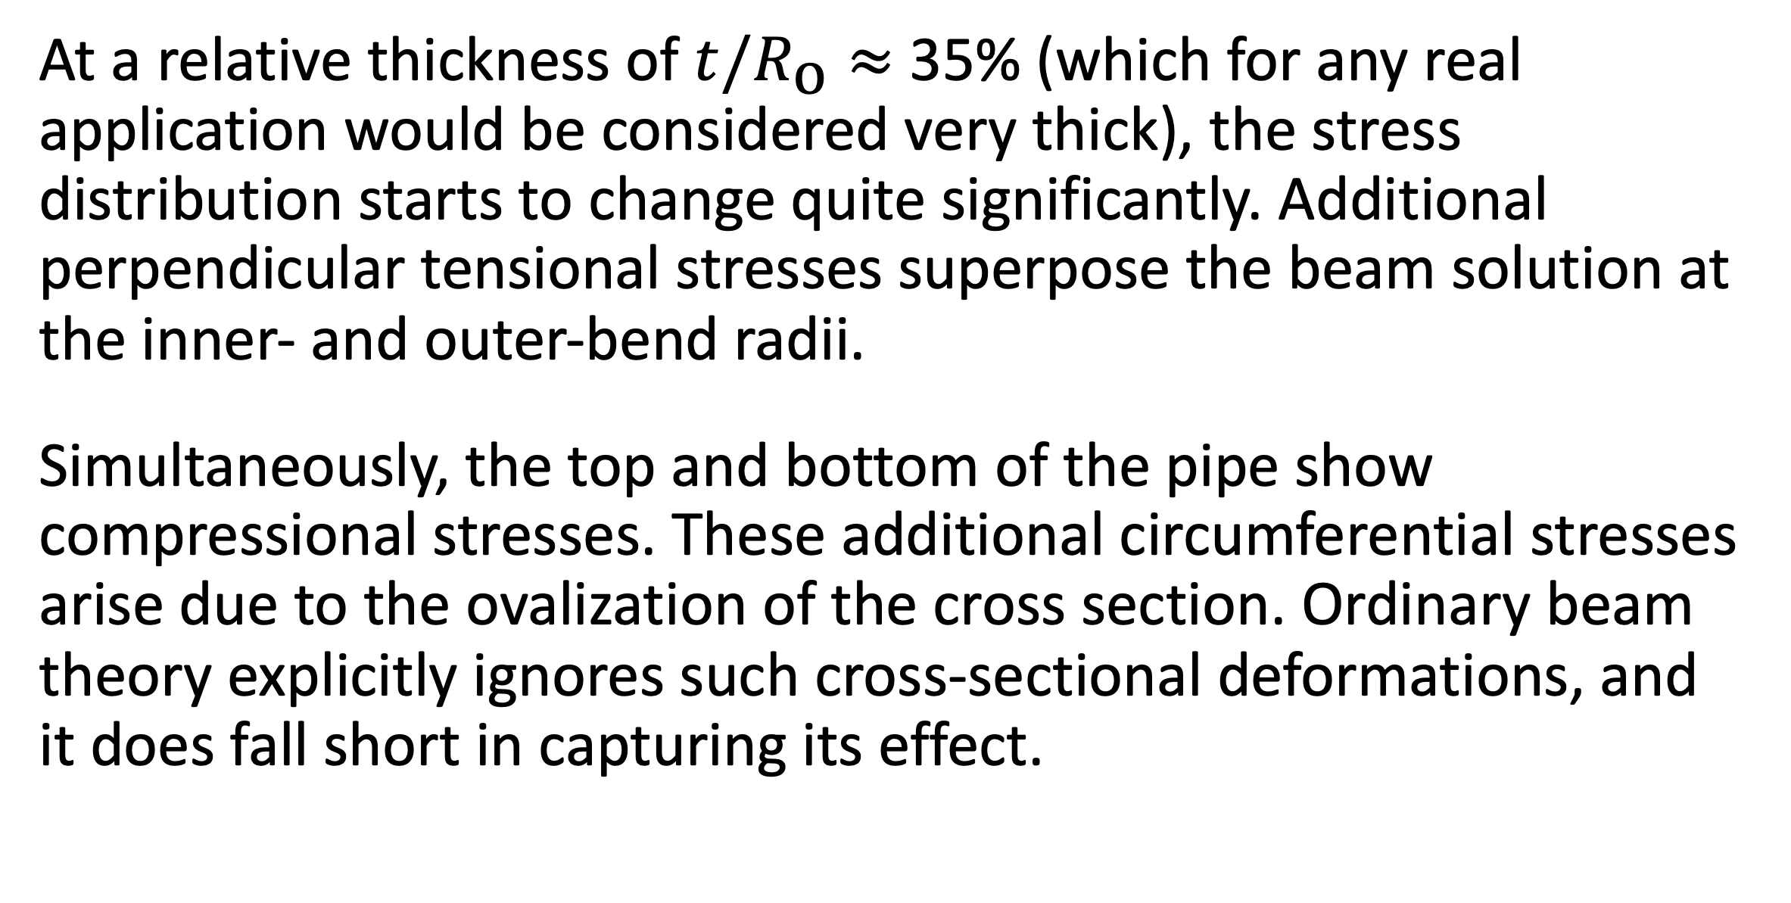
The Intriguing Stresses in Pipe Bends
For many structural engineers, beam theory is a popular analysis tool. Using the equations can be beneficial when considering structural behavior, as they are easy to apply and provide useful results. This work investigates one such case.
J. A. Smith¹, M. B. Smith²
1. Department (if applicable), Organization, City, Country.
2. Department (if applicable), Organization, City, Country.
Introduction & Goals
Pipe bends are common in piping systems, which typically transport liquids or gas, often under high pressure. One place where you may find a lot of pipes are oil tankers. The labyrinthine piping systems can look pretty fascinating.
Many piping standards (or codes) used for industrial applications are based on beam theory when it comes to the structural analysis. But, as we have already discovered, pipe bends generally do not behave like beams. When digging into piping standards, you will find a lot of information dedicated to pipe bends. In particular, piping standards recommend to apply correction factors to the stiffness and stresses for curved pipe sections. (Ref. 1)
Methodology
The pipe is slender with a constant cross section, so it would seem like a natural choice to treat such a structure as a beam in a simplified analysis. The bending moment is the only load acting on the structure, and it’s thus constant for any given section along the entire beam axis.
The maximum stress even occurs on the inside of the pipe. The cross section of the bend also deforms significantly, and, more specifically, it ovalizes with the major axis either being oriented in the bend plane or perpendicular to it depending on the direction of the bending moment.
FIGURE 1. Piping systems on an oil/chemical tanker. Image licensed under CC BY-SA 3.0 via Wikimedia Commons.
Results
At a relative thickness of $t/R_{\text{o}}≈$ 35% (which for any real application would be considered very thick), the stress distribution starts to change quite significantly. Additional perpendicular tensional stresses superpose the beam solution at the inner- and outer-bend radii.
Simultaneously, the top and bottom of the pipe show compressional stresses. These additional circumferential stresses arise due to the ovalization of the cross section. Ordinary beam theory explicitly ignores such cross-sectional deformations, and it does fall short in capturing its effect.
FIGURE 2. View of the pipe bend showing the von Mises stress (normalized) and principal stresses for different wall thicknesses.
REFERENCES
E.A. Wais and E.C. Rodabaugh, “Background of SIFs and Stress Indices for Moment Loadings of Piping Components”, United States, 2005; https://www.osti.gov/biblio/841246
“Stress Intensification Factors (i-Factors), Flexibility Factors (k-Factors), and Their Determination for Metallic Piping Components”, ASME, 2017; https://www.asme.org/codes-standards/find-codes-standards/b31j-stress-intensification-factors-flexibility-factors-determination-metallic-piping-components/2017/drm-enabled-pdf

