Slide 1
Guidelines: Presentation Structure To provide the audience with a simulation structure for each presentation we ask that you follow this general guideline.
Title slide
Title
Names and affiliations
Image
Introduction: explain the project
Why this project?
What was the challenge?
What were the goals?
Methods and use of COMSOL Multiphysics®
What methods did you use? Did you combine lab tests/experiments with your modeling?
Why did you use modeling?
How did you use COMSOL Multiphysics®?
What analyses did you run?
Expected vs. obtained results
What did your studies show?
State any conclusions
How did the results impact the project?
Include any quantifiable data points.
NOTE: The title slide will be used to create a branded version.

Slide 2
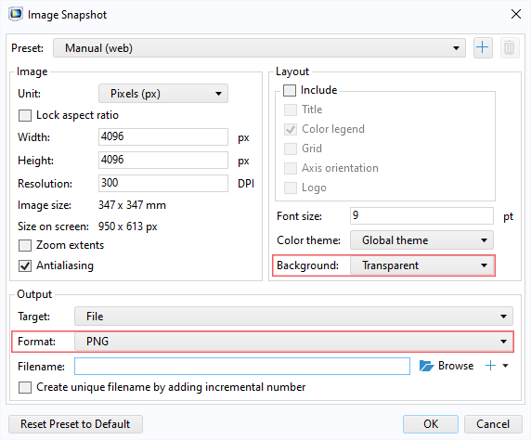
Image Guidelines
Export an image
The settings shown on the right export the highest quality image with a transparent background.
The most important settings to use are the two circled in pink. This will export an image that can be placed in the blue space of the header.

